Slide 1
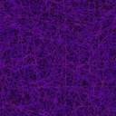

OS PROJECT REVIEW
2D GAME IN ANDROID STUDIO
NOUSHAD AHMED (2K19/CO/266)
NEERAJ GUPTA (2K19/CO/243)

Slide 2


Slide 4
GAMEPLAY- TRY TO FLY
This game is completely based on java and xml. We have used latest version of android studio to build the game. Android studio is software used for android development.
character aim in the game is to survive from the birds by killing them and such that no birds should pass the character.
The player will be scored on how many birds are killed by him .
For the animations some images are takenb from internet and some will be designed by us.

Slide 5
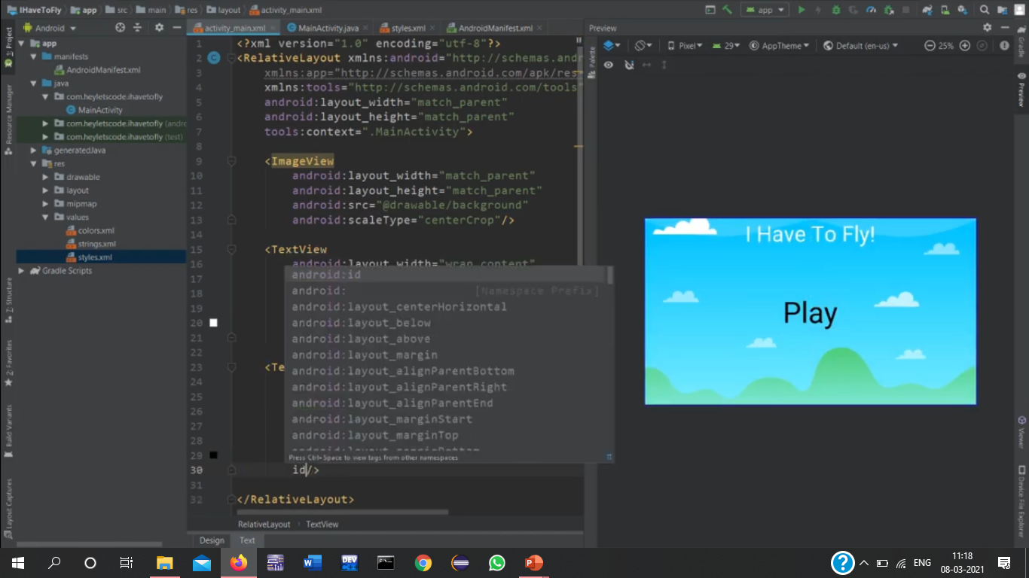
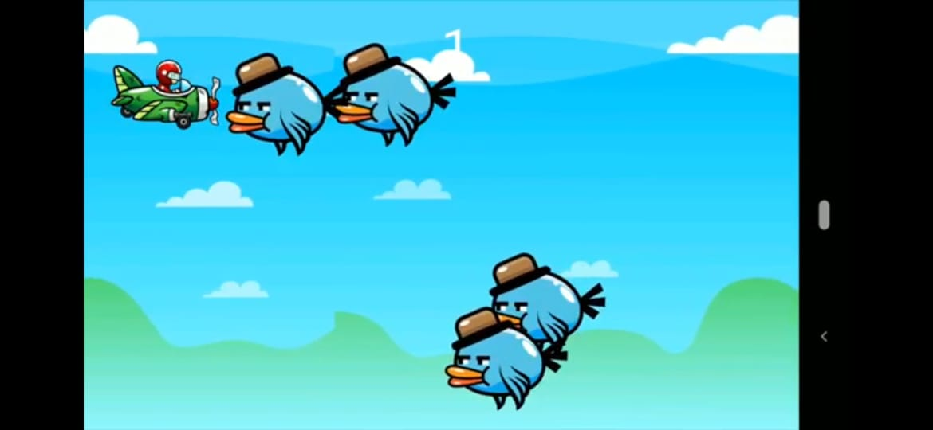
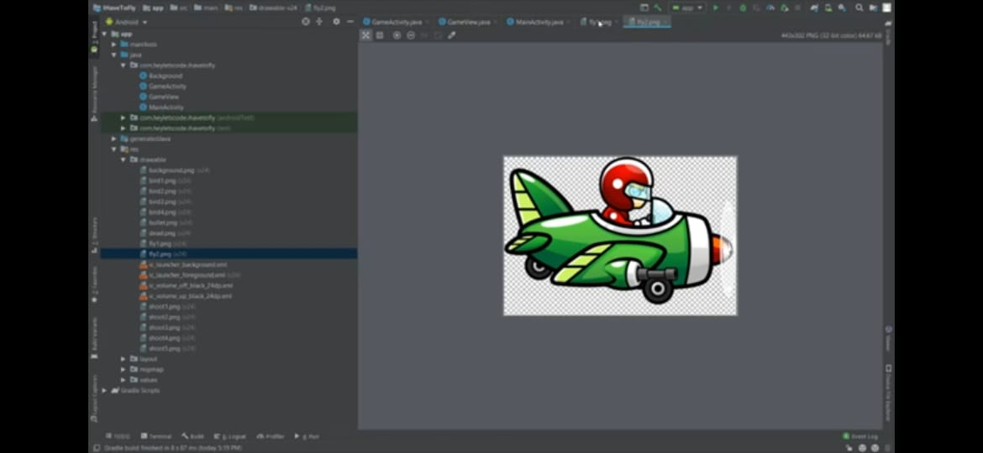
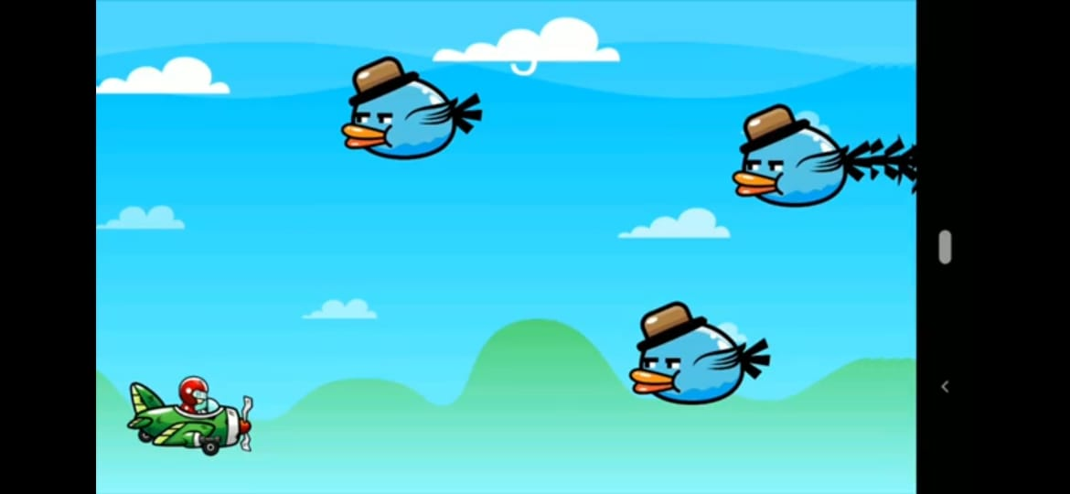

Slide 6
RULES OF GAME
Tap right side to shoot bullet.
Tap left side to fly the plane.
Don’t touch the bird.
Try to kill as many birds as possible.
Play again in case birds passes or collides the plane.

Slide 7
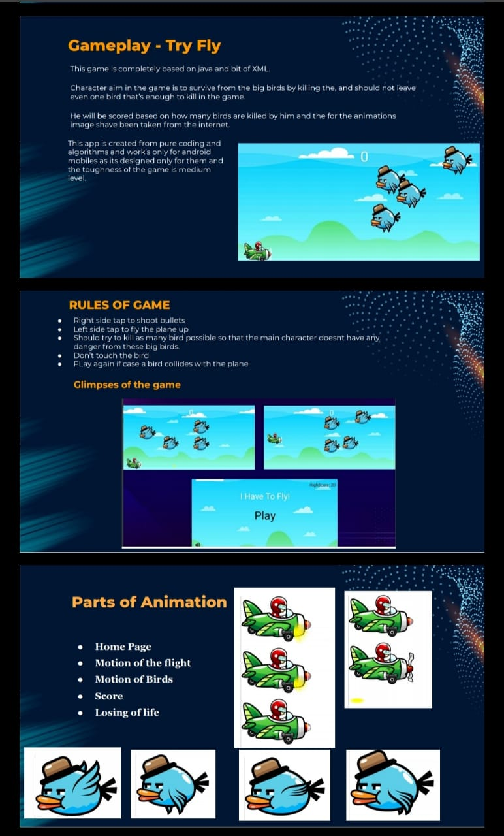
PARTS OF ANIMATION
HOME PAGE
MOTION OF PLANE
MOTION OF BIRDS
SCORE
PLANE CRASH

Slide 8
CONCLUSION
A Software project means a lot of experience. In this project we are excited to share our experience by completion of this project on 2Dgame “I Have To Fly”.
This project is a new experience to us. Since we are dealng with lot of new language like xml, and java . We are also working on graphics to give better shape to our characters.
We believe that after 1-2 months we will able to complete this project and will be able to learn a number of new things .

